Slide 1
G. Pullaiah College Of Engineering and Technology
Department of Computer Science and Engineering
IV B .Tech II Semester
MAJOR PROJECT
PROJECT TITLE:
Transformer-Based Multimodal Learning for Real-Time Disaster Tweet Classification
Kethaboyeina Bhumika (22AT1A0561)
Mandla Baby Vineetha (22AT1A0574)
Maram Sudhiksha (22AT1A0577)
S Shaima Safath (22AT1A05B4)
Project Supervisor
Mrs K. Lakshmi _{M.Tech.,(Ph.D)}

Slide 2
CONTENTS
Motivation
Objectives
Abstract
Introduction
Literature Survey
Existing System, Disadvantages
Proposed System, Advantages
System Architecture
Algorithms, Flow chart
Tools Used
Modules
UI Screens
Conclusion

Slide 3
Motivation
Social media plays a critical role during disasters
Huge amount of real-time data is generated
Difficult to identify relevant and reliable information quickly
Presence of misinformation and fake news creates confusion
Need for an automated intelligent system
Helps in faster decision-making and disaster response

Slide 4
objectives
To classify disaster-related tweets in real-time
To detect misinformation in tweets
To combine text + image (multimodal data)
To use Transformer models for better accuracy
To reduce dependency on large labeled datasets
To improve generalization across different disasters

Slide 5
ABSTRACT
This project proposes a Transformer-based multimodal framework for real-time disaster data classification and misinformation detection.
The system combines textual and visual data to improve understanding and accuracy.
Advanced models like BERT for text and CNN-based architectures for images are used to extract features.
These features are fused and classified into categories such as disaster and non-disaster. The system enhances decision-making by providing reliable and timely information during disasters.

Slide 6
INTRODUCTION
Context:
Social media platforms, specifically Twitter (X), have become a vital "real-time sensor network" during disasters. Emergency responders rely on this data for situational awareness and resource allocation.
The Problem:
Traditional manual monitoring is impossible due to the massive volume and speed of data. Existing automated systems are often limited because they are unimodal (only analyze text) or offline (not real-time). This makes them susceptible to "noise," metaphorical language (e.g., "This pizza is a disaster"), and misinformation like "recycled" images from past events.
The Solution:
This project proposes a Transformer-Based Multimodal Framework that processes both text and images simultaneously.
Technology: It utilizes a dual-encoder architecture featuring BERT for deep textual analysis and a Vision Transformer (ViT) for spatial image features.

Slide 7
LITERATURE SURVEY
Author & Year | Method Used | Key Contribution | Limitation
S. Gandharv, V. Richhariya, & V. Richhariya (2017) | Foundational text mining and real-time ingestion logic for Twitter streams. | Established the architectural logic for real-time streaming ingestion during active disasters. | Primarily focused on text mining; lacks support for visual/multimodal data.
J. Devlin, M. -W. Chang, K. Lee, & K. Toutanova (2019) | BERT (Bidirectional Encoder Representations from Transformers). | Revolutionized NLP by capturing bidirectional context to extract deep semantic intent from tweets. | Purely text-based model; ignores complementary visual evidence from images.
S. Singhal, R. R. Shah, et al. (2019) | Multimodal late fusion using VGG-19 for images and traditional text models. | One of the first frameworks to combine text and images for detecting misinformation. | Uses older CNN models (VGG-19) which lack the spatial extraction power of ViT.
F. Alam, F. Ofli, & M. Imran (2018) | Annotation and labeling methodology for multimodal datasets. | Provided CrisisMMD, a large-scale benchmark for training disaster-related AI models. | Focused on static datasets; does not address real-time streaming latency.
R. Koshy & S. Elango (2022) | Transformer-based bidirectional attention model. | Improved classification by modeling the inter-modality relationships between text and images. | Lacks a unified multi-task pipeline for concurrent misinformation detection.

Slide 8
Existing System & Disadvantages
Existing System: Most current approaches rely on traditional Machine Learning or simple Deep Learning (CNN/LSTM) using text-only (unimodal) data.
Disadvantages:
Ignores Visual Evidence: Fails to use the rich information found in images.
High Latency: Models are often too "heavy" for real-time deployment.
Vulnerability to Misinformation: Cannot detect "mismatches" where the text claims a disaster but the image is unrelated.
Poor Generalization: These models struggle to adapt to new types of disasters they weren't specifically trained on.

Slide 9
PROPOSED SYSTEM
Multimodal Learning : Combines both text and image data for better understanding
Transformer-Based Text Analysis : Uses models like BERT / RoBERTa for accurate semantic extraction
Image Feature Extraction : Uses CNN models (ResNet/VGG) to analyze disaster-related images
Real-Time Processing : Classifies tweets instantly from live social media streams
Transfer Learning : Uses knowledge from past disasters to handle new events
Misinformation Detection : Identifies fake or misleading tweets

Slide 10
ADVANTAGES
Multimodal Learning: It combines both text and image data to achieve a better and more comprehensive understanding of social media posts.
Transformer-Based Text Analysis: The system utilizes advanced models like BERT / RoBERTa for highly accurate semantic extraction from text.
Image Feature Extraction: It uses CNN models (such as ResNet or VGG) to specifically analyze and extract features from disaster-related images.
Real-Time Processing: The framework is designed to classify tweets instantly as they arrive from live social media streams.
Transfer Learning: It leverages knowledge and patterns learned from past disasters to effectively handle and classify new, unseen events.
Misinformation Detection: The system includes a layer to identify and filter out fake or misleading tweets to ensure data reliability.

Slide 11
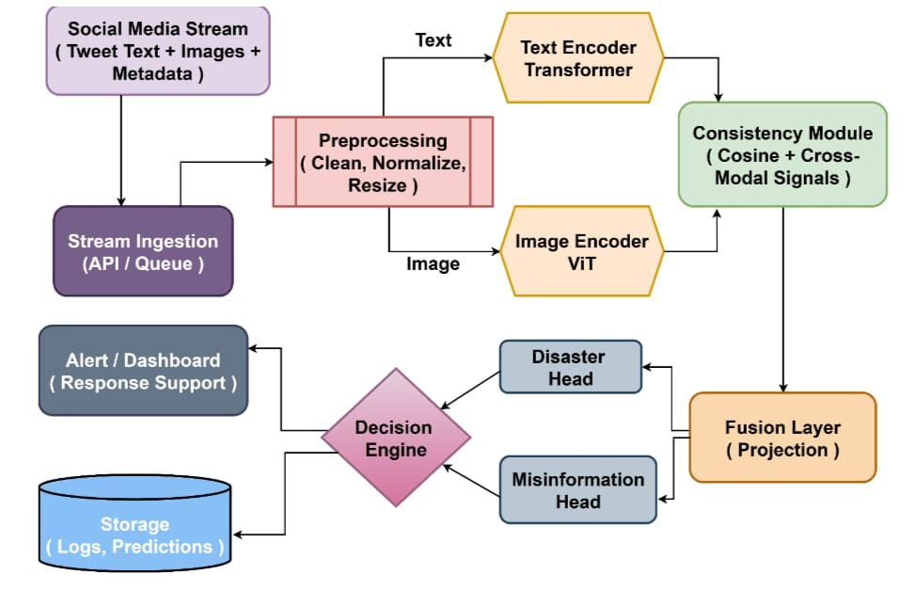
SYSTEM ARCHITECTURE
The System Architecture is a four-layer framework designed for real-time multimodal processing:
Presentation Layer: A web-based Dashboard (HTML/Tailwind) where users input tweets/images and view results.
Application Layer: A Flask Backend that manages user authentication (PBKDF2), API requests, and system logic.
AI & Inference Layer (Core):
BERT: Processes text for deep semantic meaning.
Vision Transformer (ViT): Extracts features from images.
Fusion Module: Uses Cosine Similarity to check if the text and image match (filtering misinformation).
Data Storage Layer: A persistent database that stores Prediction History and system logs for analytics.

Slide 12
ALGORITHMS
Proposed System Advantages
Transformer Encoders (BERT):
Purpose: Used for deep textual feature extraction.
Benefit: Captures the bidirectional context of words in a tweet better than traditional models.
Vision Transformers (ViT):
Purpose: Used for high-level visual feature extraction from images.
Benefit: Replaces traditional CNNs (like ResNet) by using "Self-Attention" to understand global image context.
Cross-Modal Consistency-Aware Fusion:
Purpose: The "brain" of the project that compares text and image features.
Technique: Uses Cosine Similarity to mathematically detect if the image matches the text (to catch fake news).
Transfer Learning:
Purpose: Leveraging pre-trained knowledge from large-scale datasets (like CrisisMMD).
Benefit: Allows the model to work on new disasters even with limited labeled data.

Slide 13
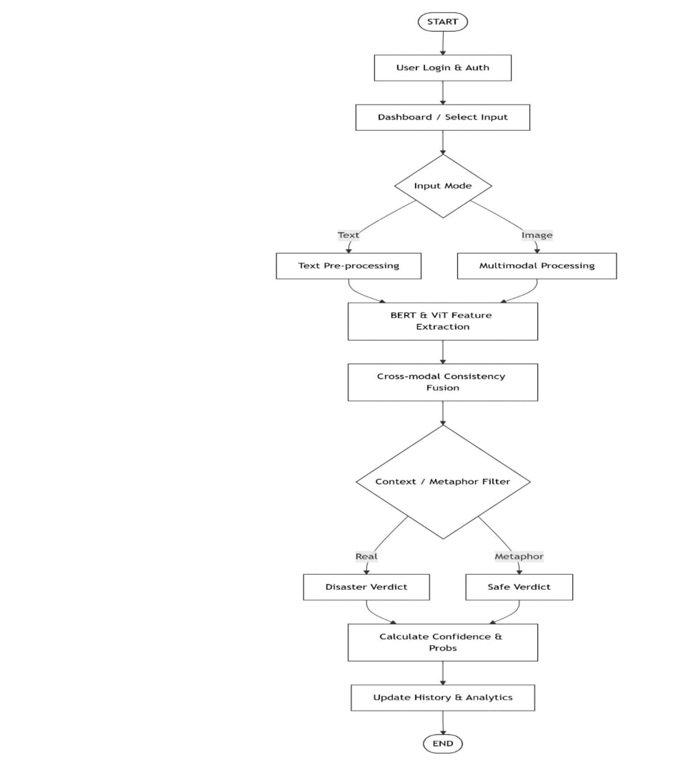
FLOWCHART

Slide 14
TOOLS USED
Hardware Requirements
Processor: Intel Core i7 or equivalent high-end CPU
RAM: 16 GB or higher (to handle Transformer inference)
Hard Disk: 250 GB SSD or above
GPU: NVIDIA GPU with 8GB VRAM (Crucial for BERT & ViT models)
Network: 100 Mbps or above (Required for live data streaming)
Display: 1024 x 768 or higher resolution
Software Requirements
Operating System: Windows 10/11 or Ubuntu Linux
Programming Language: Python 3.9 or above
Deep Learning Framework: TensorFlow, Keras
NLP & Cleaning Libraries: NLTK, Regular Expressions (Regex), NumPy
Backend Framework: Flask (Python-based WSGI web framework)
Frontend Technologies: HTML5, CSS3, Tailwind CSS, JavaScript (ES6+)
Visualization Library: Chart.js (for real-time analytics dashboards)

Slide 15
Modules
Data Collection Module Collects real-time disaster-related social media data. Extracts text, images, and metadata, and stores the raw multimodal data for further processing.
Data Preprocessing Module Processes raw data to make it suitable for model input. Text: Noise removal, tokenization, normalization, and stopword removal Image: Resizing, pixel normalization, and format conversion
Feature Extraction Module Extracts meaningful features from both modalities: BERT Model: Captures contextual textual features CNN / ResNet: Extracts visual features from images with classes: Disaster |Non-disaster.

Slide 16
Multimodal Fusion Module Combines text and image feature vectors using techniques like concatenation or attention mechanisms to form a unified representation.
Classification Module Uses a Fully Connected Neural Network with Softmax activation to classify the data into sentiment categories.
Output Module Generates final predictions with classes: Disaster |Non-disaster.

Slide 17
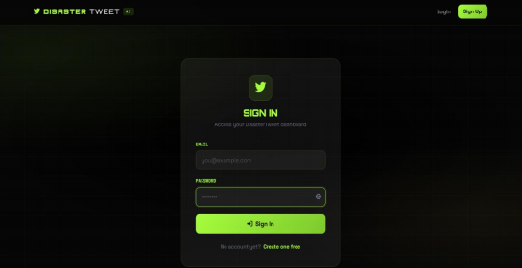
UI SCREENS

Slide 18
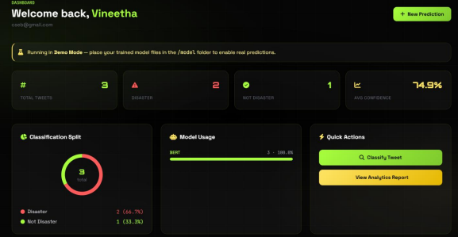

Slide 19
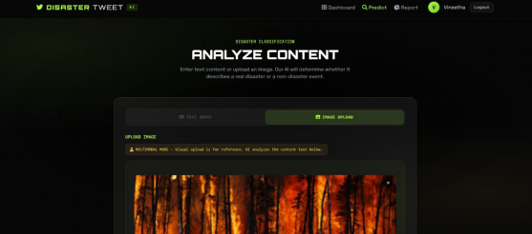

Slide 20
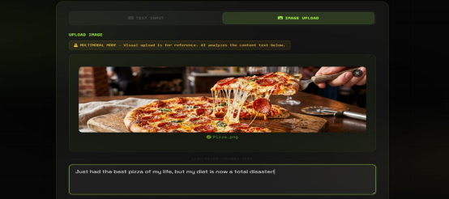

Slide 21
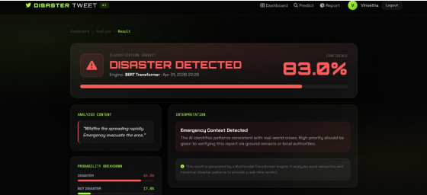

Slide 22
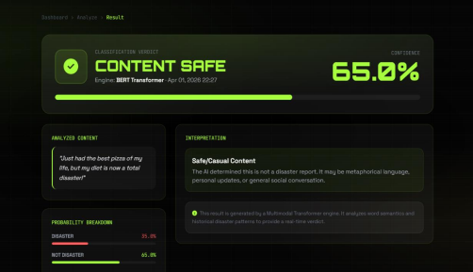

Slide 23
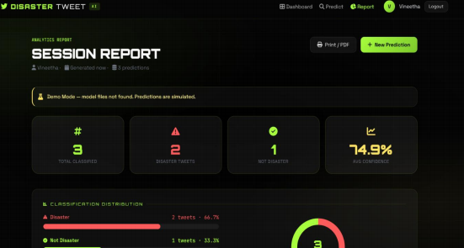

Slide 24
CONCLUSION
Proposed system improves disaster tweet classification
Combines Transformer + Multimodal Learning
Supports real-time analysis
Reduces misinformation impact
Useful for:
Disaster response teams
Government agencies
Future scope:
Integration with live systems
Expansion to other social platforms

Slide 25
THANK YOU

